Slide 1
INF10025
Data Management and Analytics
Lecture 10 - Part 1
Normalization
NoSQL databases
JSON

Slide 2
NORMALIZATION
  Normalization is a database design technique used to generate relational schemas
  Normalization is often used as an alternative to:
    ERDs
  Normalization requires no diagrams
  An aim of Normalization is to achieve 3rd Normal Form 3NF.
    You will hear database analysts frequently use the expression 3rd Normal Form as a desired outcome of the database design effort.

Slide 3
Stages of Normalization
Unnormalized tables have potential anomalies:
  Insert
  Update
  Delete
The potential anomalies above can be avoided by "normalizing" the database
There are several stages of normalisation
  At each stage a another potential source of anomalies is removed.

Slide 4
Stages of Normalization
These stages of normalization are covered this lecture/semester:
Stage of Normalization Abbreviation Description
First normal form 1NF Remove Repeating groups
Second normal form 2NF Remove Part Key Dependencies
Third normal form 3NF Remove Non Key Dependencies
Stages of normalization below are not covered this lecture /semester:
Most database developers do not use / know beyond 3NF
Normalization beyond 3NF (rarely used in practice)
Stage of Normalization Abbreviation Description
Boyce-Codd normal form BCNF Remove Non Key Determinants
Fourth normal form 4NF Remove Multivalued Dependencies
Fifth normal form 5NF Remove Join Dependencies

Slide 5
Normalization by Decomposition
This is an example of an unnormalized table ( 0NF )
There are multiple values in a single cell.
These are known as repeating groups.

Slide 6
Removal of Repeating Groups generates 1NF
This relation is First Normal Form - 1NF.
This relation is also Known as The Universal Relation.
All repeating groups have been removed.
  All data is in a one large relation
  Each cell in a row has a maximum of 1 value

Slide 7
Identification of Primary Key
What is the primary key of this Universal Relation?
The PK must be determined at the outset and
before normalization can continue.
    The PK is often difficult to determine
        The more columns you have, the harder it gets
    PK identification is largest problem in the Normalization

Slide 8
Identification of Primary Key
What is the primary key of this Universal Relation?
StuId and SubCode seem to be fewest columns required to uniquely identify each row
While additional columns may also uniquely identify every row,
you must reduce to number of columns to the fewest possible
The key identified in known as the Universal Key

Slide 9
Functional Dependency
To achieve 2nd Normal Form, you must identify functional dependencies.
  This is where one attribute can be determined by another attribute.
  e.g. StuId determines the Studentname
    There is only one Studentname for this StuId
  StuId → Studentname
If in doubt, ask yourself:
  "Is there only ONE student name for that StuId ?"
  If your answer is “Yes” then there is a functional dependency

Slide 10
Remove PART-KEY dependencies (1NF -> 2NF)
The Universal Key of the Universal Relation is StuId, SubCode
What is a Part Key dependency?
  A Part Key dependency is where a column in the Universal Relation is dependent on only part of the Universal Key.
This Universal Key is made up of two columns.
Consider Stuid (one half of the UK)
Are any columns in the Universal Table dependent on only StuId ?
Yes
    Studentname is dependent only on StuId
    It is not dependent on SubCode.
Therefore studentname has a Part-Key Dependency
  A dependancy because Studentname is dependent on StuId
  It's Part-Key because StuId is part of the UK

Slide 11
Remove PART-KEY dependencies (1NF -> 2NF)
Remove the part-key dependencies
  Place the determinant (StuId) in a new table.
    The determinant is the Primary Key of the new relation
    Give the new table a name (e.g STUDENT)
    STUDENT (StuId , studentname)
  Are there any other dependencies based on StuId. Yes
    Course is a dependency
      STUDENT (StuId , studentname, course)
    What have we done?
      Essentially, we have removed a 'strong entity' type relation from the Universal Relation

Slide 12
Remove PART-KEY dependencies (1NF -> 2NF)
A Part-Key dependencies have been removed from the UR
A new Student Relation has been created.
Note. The column StuId exists in both relations.
UR.Stuid is a Foreign Key value that refers to Student
Universal Relation
Student Relation

Slide 13
Remove PART-KEY dependencies
What about the other column in the UK
Are there any part key dependencies based on SubCode? YES
  SubCode → subjecttitle
  SubCode → convenorname
  SubCode → convenorlocation
Move part key dependencies to a new relation.
    SUBJECT (SubCode , subjecttitle, convenorname, convenorlocation)

Slide 14
Remove PART-KEY dependencies
All Part-Key dependencies have been removed from the UR
Note. StuId & SubCode in the UR are FKs referring to 'strong' relations.
Universal Relation
Subject Relation
Student Relation
Foreign Keys

Slide 15
Removal of Non-Key Dependencies (2NF -> 3NF)
A Non-Key dependency is a where
  a column has a dependency on another column
  AND the other column is NOT part of the Universal Key
Are there any attributes in the
Universal Relation that
are not dependant on the
Universal Key?
Convenor Location is not
dependent on StuId + SubCode
It is dependant on Convenor Name (which is not part of the UK)
Subject Relation

Slide 16
Removal of Non-Key Dependencies
What is the Convenor location attribute dependent on?
  Convenor location is dependent on the Convenor name.
Place the determinant ConvenorName into a new relation.
  ConvenorName is the Primary Key for the new relation
Place the dependencies of ConvenorName into this new relation
      CONVENOR( Convenorname, Convenorlocation )
  By Removing all Non-Key dependencies
  We have moved from 2NF to 3NF.
  The database is now NORMALIZED

Slide 17
Removal of Non-Key Dependencies
Removal of NonKey Dependencies
Note:
The column ConvenorName
remains in both relations
2NF 3NF
Foreign Key

Slide 18
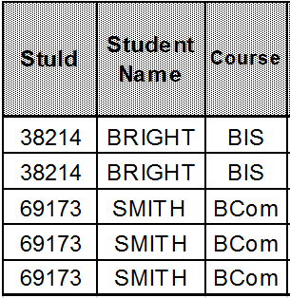
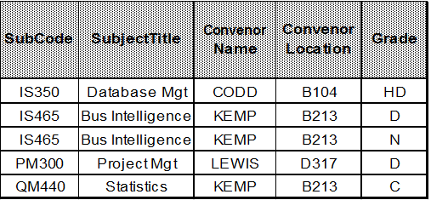
Third Normal Form 3NF
Recap: Remove a part key dependency based on StuId

Slide 19
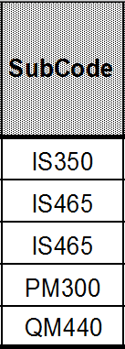
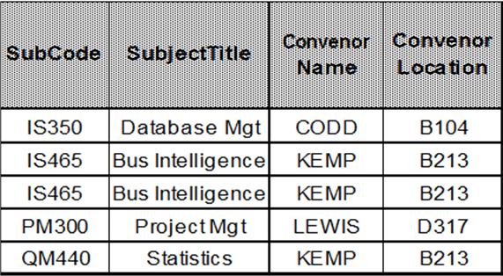
Third Normal Form 3NF
Recap: Remove a part key dependency based on SubCode

Slide 20
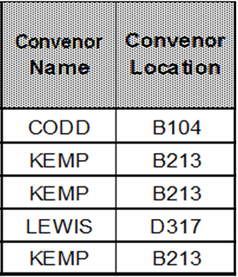
Third Normal Form 3NF
Recap: Remove non key dependency on convenor name

Slide 21
Third Normal Form 3NF
All relations are now in 3NF
Foreign Keys

Slide 22
Steps to achieve Third Normal Form
Start with the Universal Relation. One large relation (table)
  Step 1: Eliminate repeating groups by ensuring every cell has a value
    You now have 1NF
  Step 2: Identify the Universal Key (primary key)
  Step 3: Remove Part Key dependencies
    Do any attributes of UR have FD with part of the UK?
      If so, create a new relation with the determinant and dependants
      You now have 2NF
  Step 4: Remove Non Key dependencies
    Do any attributes have FD with a column that is not part of the UK?
      If so, create a new relation with the determinant and dependants
      You now have 3NF

